Slide 1

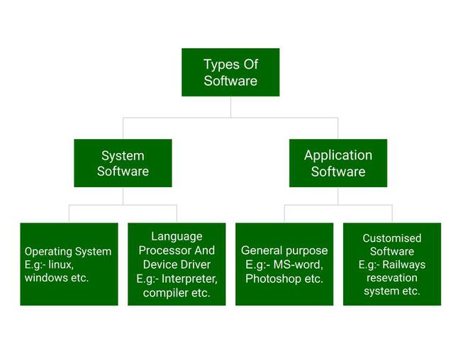
SOFTWARE
Software is the collection of data, programs, procedures, routines and instructions that tell a computer or electronic device how to run, work and execute specific tasks.

Slide 3
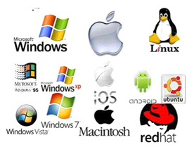
System Software
System software is software that directly operates the computer hardware and provides the basic functionality to the users as well as to the other software to operate smoothly
Operating System It is the main program of a computer system. When the computer system ON it is the first software that loads into the computer’s memory

Slide 4
System Software
Language Processor As we know that system software converts the human-readable language into a machine language and vice versa.
Device Driver A device driver is a program or software that controls a device and helps that device to perform its functions. Every device like a printer, mouse, modem, etc. needs a driver to connect with the computer system eternally.

Slide 5
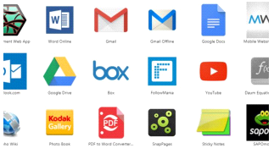
Application Software
Software that performs special functions or provides functions that are much more than the basic operation of the computer is known as Application software.
General Purpose Software: This type of application software is used for a variety of tasks and it is not limited to performing a specific task only

Slide 6
Application Software
Customized Software: This type of application software is used or designed to perform specific tasks or functions or designed for specific organizations.
Utility Software: This type of application software is used to support the computer infrastructure. It is designed to analyze, configure, optimize and maintains the system, and take care of its requirements as well.

Slide 7
Difference
System software | Application software
It is designed to manage the resources of the computer system, like memory and process management, etc | It is designed to fulfill the requirements of the user for performing specific tasks.
Written in a low-level language. | Written in a high-level language
Less interactive for the users. | More interactive for the users
System software plays vital role for the effective functioning of a system. | Application software is not so important for the functioning of the system, as it is task specific

